Slide 1
Real-time Analytics End-to-End Workshop
Develop a complete Microsoft Fabric solution leveraging real-time analytics, data warehousing, data lakehouse, Data Activator, data science, and Power BI.
https://aka.ms/fabricrealtimelab

Slide 2

01
Welcome and Schedule
Content
02
Microsoft Fabric Overview
03
Fabric Workshop
04
Wrap-up, Q&A, Feedback

Slide 3
Welcome

Slide 4
Fabric Workshop Schedule
8:30-9:00
Check-in and registration
9:00-9:15
9:15-9:45
Introduction
9:45-10:30
10:30-10:45 Break
Explore end-to-end analytics with Fabric
Real-time Analytics Overview
LAB: Ingesting Data using RTA
10:45-11:45
From KQL to Power BI Reports
LAB: Using KQL and building reports
11:45-12:30 Lunch Break
12:30-2:00
3:00-4:30
Data Lakehouse with notebooks
Data Science in Fabric
2:45-3:00 Break
Wrap up & feedback
2:00-2:45 Elective
LAB: Building a Data Lakehouse
LAB: Data Warehouse
LAB: Data Activator
4:30-4:45
LAB: Building ML models to predict stock prices
Continue the journey
LAB: Advanced KQL
LAB: Delta File Maintenance

Slide 5
Full Day Schedule
Module 0 9:00-9:30 AM
Solution overview and initial setup
Module 1 & 2 9:30-10:15 AM
Module 3 10:15 – 10 :45 AM
Lunch Break 11:30 – 12:30 PM
Module 5 12:30pm – 2:00 PM
Module 6 2:00-3:00 PM
Module 7 3:15-4:30 PM
KQL Databases and KQL Querysets
Power BI Real-time Reports
Synapse Data Warehouse and pipelines
Data Lakehouse with notebooks
Data Science – Building ML models
Break and Review 10:45 – 11:00 AM
Module 4 11:00 – 11:30 AM
Data Activator
Break and Q&A 3:00 – 3:15
Closing 4:30 – 4:45 PM
Feedback and next steps
Notes:
Example full day schedule

Slide 6
Half Day Schedule
Modules 1-3 9:00 – 10:00 AM
Solution Overview
Setup
Module 6
10:00 – 11:00 AM
Module 7
11:00 – 12:30 PM
Closing 12:30pm – 1:00 PM
Module 6: Lakehouse
Data Science
Q&A, Feedback, and next steps
Medallion Architecture, notebooks, and data wrangler
Build ML models to predict stock prices
Notes:
Example half day schedule

Slide 7
3 Day Lunch & Learn
Day 1 Modules 1-3
Setup, KQL, Reports
Day 2 Module 6
Day 3 Module 7
Data Science
Lakehouse
Build ML models to predict stock prices
Solution Overview
Medallion Architecture, notebooks, and data wrangler
Notes:
Example 3-day lunch and learn schedule: recommend picking lakehouse or warehouse for day 2.

Slide 8
Microsoft Fabric Overview
Notes:
Instructor notes: the overview of Fabric is designed to be very short, with the emphasis on getting started right away and introducing concepts as the day progresses.

Slide 9

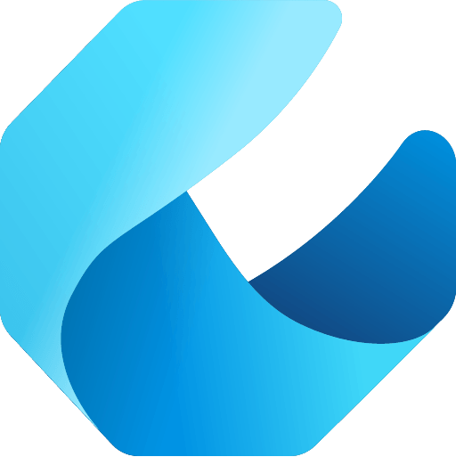



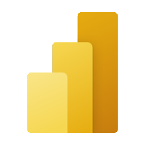


Microsoft Fabric does it all—in a unified solution
An end-to-end analytics platform that brings together all the data and analytics tools that organizations need to go from the data lake to the business user
Data Integration
Data Engineering
Data Warehouse
Data Science
Real Time Analytics
Business Intelligence
Observability
Data Factory
Synapse
Synapse
Synapse
Synapse
Power BI
Data Activator
Unified data foundation
OneLake
UNIFIED
SaaS product experience
Security and governance
Compute and storage
Business model

Slide 10









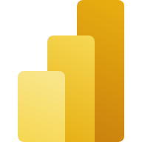



Empower your data professionals to move faster and unlock more value from your data
Data Engineers
Data Scientists
Data Analysts
Data Citizens
Execute faster with the ability to spin up a Spark VM cluster in seconds, or configure with familiar experiences like Git DevOps pipelines for data engineering artifacts
Streamline your work with a single platform to build and operate real-time analytics pipelines, data lakes, lake houses, warehouses, marts, and cubes using your preferred IDE, plug-ins, and tools.
Reduce costly data replication and movement with the ability to produce base datasets that can serve data analysts and data scientists without needing to build pipelines
Quickly tune a custom model by integrating a model built and trained in Azure ML in a Spark notebook
Work faster with the ability to user your preferred data science frameworks, languages, and tools
Bypass engineering dependencies with the ability to use your preferred no-code ML Ops to deploy and operate models in production
Tap into proven-at-scale models and services to accelerate your AI differentiation (AOAI, Cognitive Services, ONNX integration, etc).
Avoid slow, progress-stagnating data wrangling by seamlessly triggering a workflow that can unlock data engineering tools and capabilities quickly.
Accelerate your work with visual and SQL based tools for self-serve data transformations and modeling as well as self-serve tools for reporting, dashboards, and data visualizations
Turn data into impact with industry-leading BI tools and integration with the apps your people use everyday like Microsoft 365
Make more data-driven decisions with actionable insights and intelligence in your preferred applications
Maintain access to all the data you need, without being overwhelmed by data ancillary to your role thanks to fine grain data access management controls
Serve data via warehouse or lakehouse
Serve transformed data
Serve insights via embedding
Supporting experiences:
Supporting experiences
Supporting experiences
Supporting experiences
Data Factory
Data Warehouse
Data Science
Azure ML
Data Warehouse
Real-time analytics
Power BI
Power BI
Microsoft 365
Data Engineering
Real-time analytics
Serve data via warehouse or lakehouse
Data Stewards
Maintain visibility and control of costs with a unified consumption and cost model that provides evergreen spend optics on your end-to-end data estate
Gain full visibility and governance over your entire analytics estate from data sources and connections to your data lake, to users and their insights

Slide 11
The Workshop

Slide 12
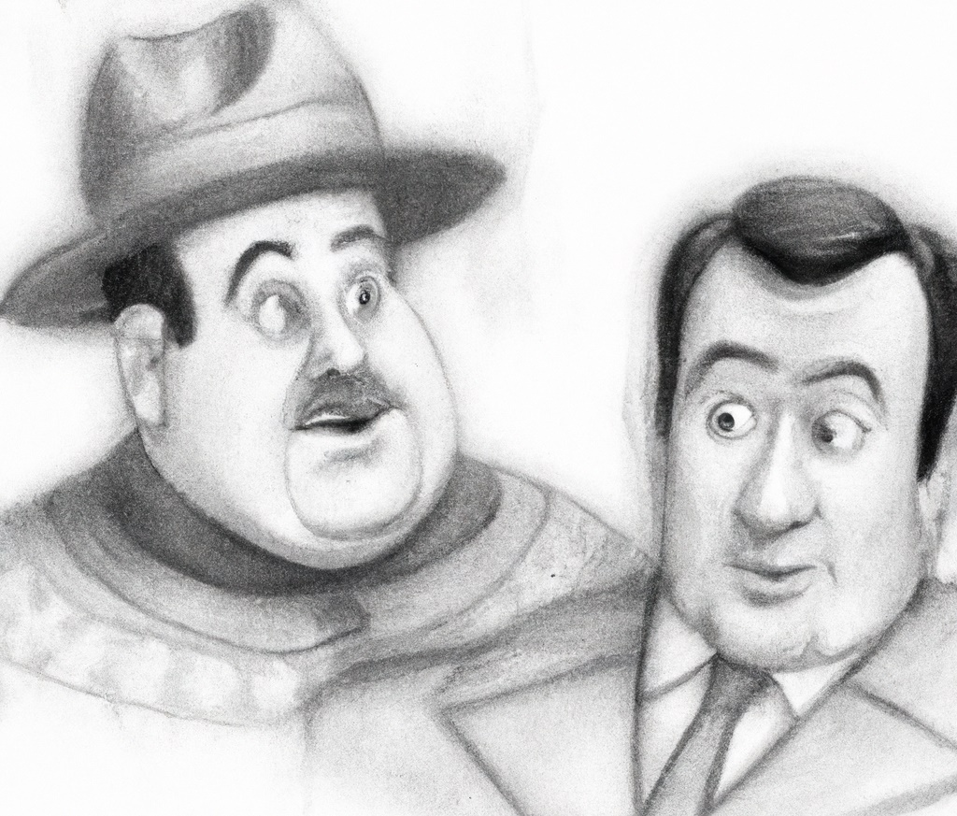
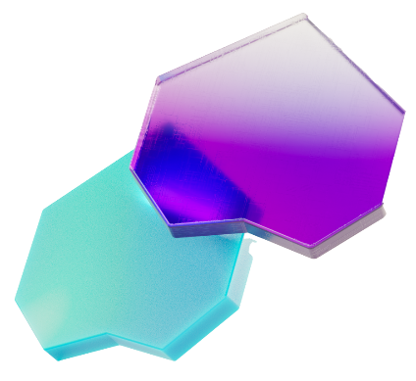
Scenario Overview
AbboCost Financial is a small firm that monitors several volatile stocks. Their current data feed provides stock prices in real time. This feed is all you have to work with.
Your goal: support the development of this fledgling company by developing a modern data analytics solution.

Slide 13
Lab
Environment
Setup

Slide 14
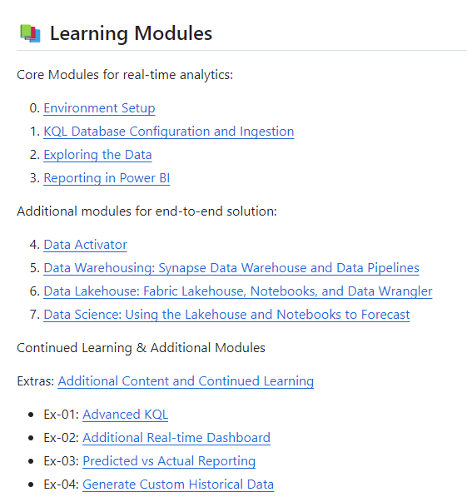
Lab Environments
Modules
Content for labs
https://aka.ms/fabricrealtimelab
(Placeholder: lab access notes/guidelines)

Slide 15
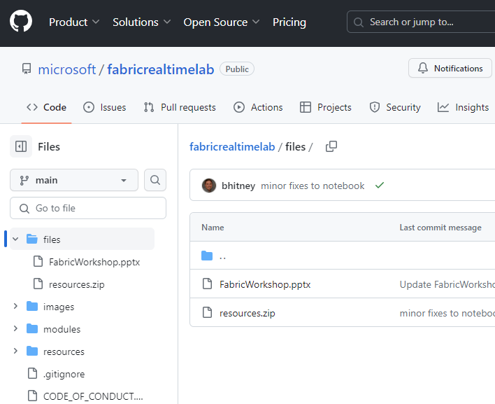
Lab Environments
Resources
Content for labs
https://aka.ms/fabricrealtimelab
All modules are documented; will likely be skipping Module 04 (Data Activator) due to time constraints.
Resources file (in /files folder)
https://aka.ms/fabricrealtimelab-resources
You can either clone the repo, download files as you go, or download the resources.zip file which contains the notebooks and scripts used throughout the lab.
Notes:
Include any specific logistics – access to lab environments, if available, trial (https://learn.microsoft.com/en-us/fabric/get-started/fabric-trial), etc.

Slide 16
Module 0 Introduction to Real-time Analytics and Setup

Slide 17

Common Real-time Analytics Patterns
Data Source
Ingestion
Store
Expose
Lakehouse & Data Warehouse
CI & Shortcuts
Kusto DB
PBI
Structured / Unstructured
Pipeline & Dataflows
Kusto Query
Event Streaming
Mirror
Notebook
Lakehouse & Data Warehouse
ML Model
Notes:
Unlike the Data Science, Lakehouse, and Data Warehouse analytics scenarios, streaming data can be ingested into the Microsoft Fabric in several ways to achieve real-time analytics.
Users can leverage Event Hub, IoT Hub, pipelines, dataflows, notebooks, or open-source products like Kafka, Logstash, and more.
Once ingested into the Microsoft Fabric, streaming data can be stored in Kusto DB and mirrored into Lakehouse. After the data has been stored, machine learning models can be trained and tested directly on the Lakehouse with experiments.
Like the other scenarios, business users can analyze and visualize the data with Power BI using the see-through mode or SQL endpoints. Data can also be exposed through KQL or notebooks using Spark.

Slide 18
Fabric Real-Time Analytics (RTA)
Find insights, track progress, and make decisions faster.
Eventstream
KQL Queryset
Eventhouse (preview)
Real-Time Dashboards in KQL (preview projected for Q1)
KQL Database
Power BI
Data Activator

Slide 19
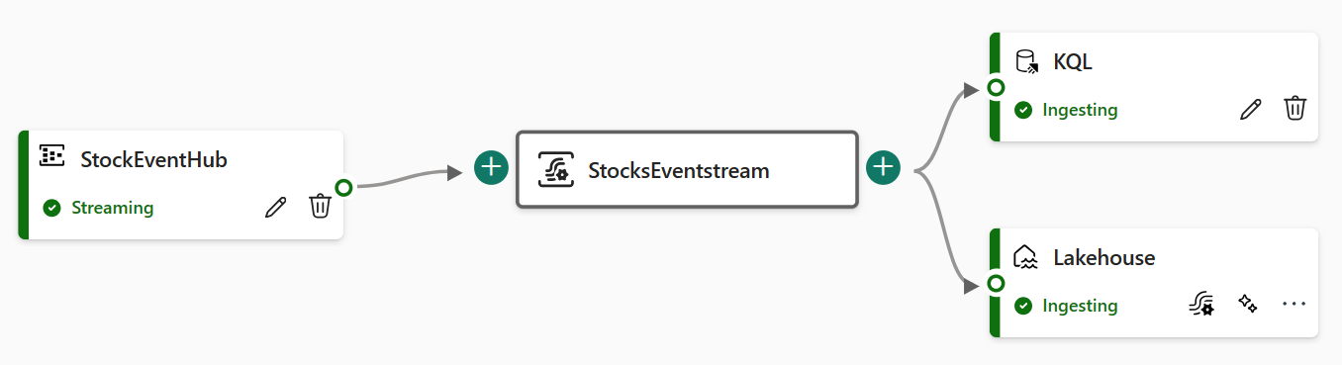
Eventstreams
Key Capabilities
Centralized place for event data
Capturing, transforming, and routing event data.
Various source connectors
Fetch event data from diverse source, such as
Custom Apps to push into Eventstreams, Azure Event Hub or Samples.
No-code experience
Drag and drop makes it intuitive and easy to use.
Build an end-to-end data flow diagram.
Multiple destinations
Lakehouse, KQL Database, Custom App, Data
Activator (Reflex)

Slide 20
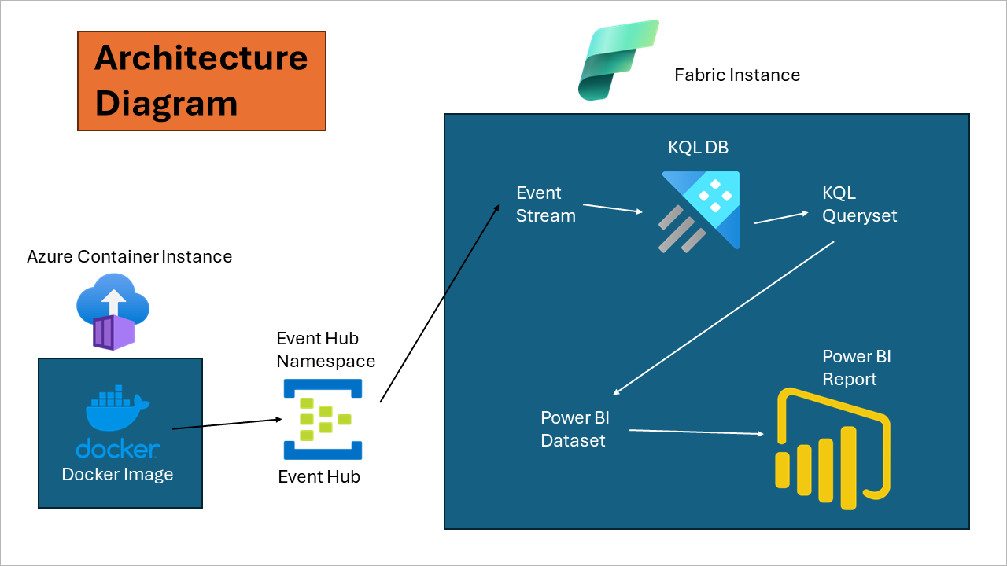
Notes:
Include any specific logistics – access to lab environments, if available, trial (https://learn.microsoft.com/en-us/fabric/get-started/fabric-trial), etc.

Slide 21
Module 0 – Introduction & Setup
Goals: Understand the solution and connect to the workshop Event Hub. (You may run the generator yourself, if you prefer.)
The data feed will produce 3 pieces of information: stock symbol, current price, and timestamp.

Slide 22
Module 1 KQL Database

Slide 23
Unlimited Scale (query, ingestion, storage)
Any data source
Any data format
Structured Semi-Structured Free-text
Real-time data Transformation of complicated data structure
Streaming analytics in NRT
High performance Low latency High freshness
Timeseries database
Everything is indexed and partitioned
KQL Database
Key Capabilities

Slide 24
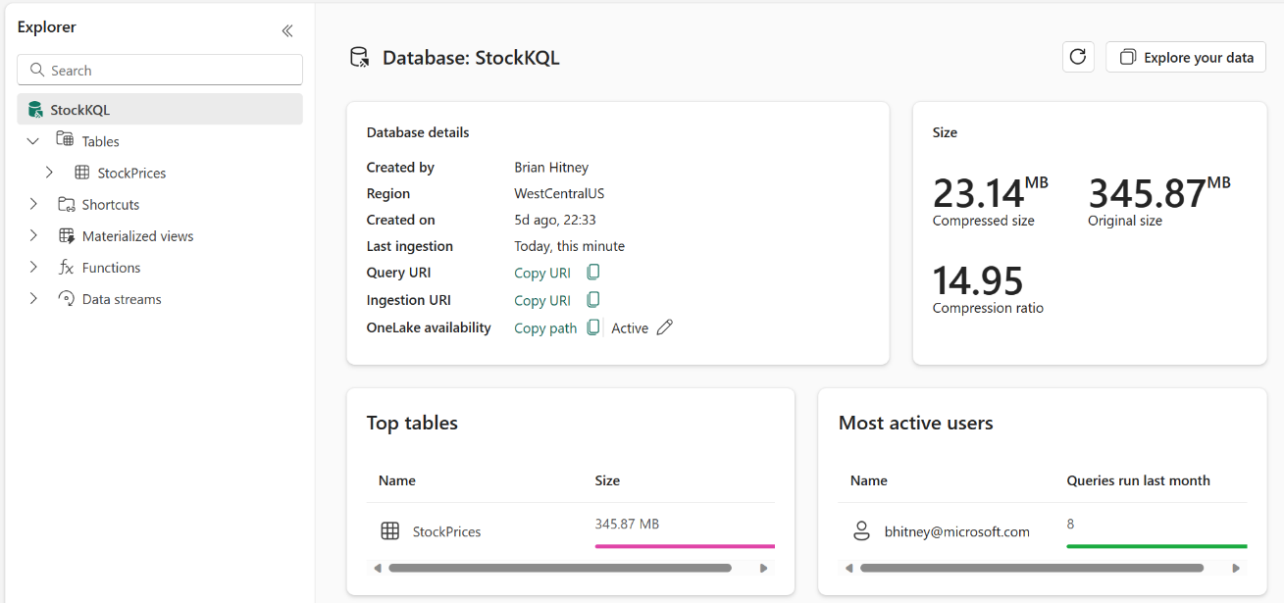
Module 1 – KQL Database Setup
Goals: Create and configure a KQL database to ingest data
With data being fed to the Eventstream, this module focuses on creating and KQL database as a data sink.

Slide 25
Module 2 KQL Queries

Slide 26
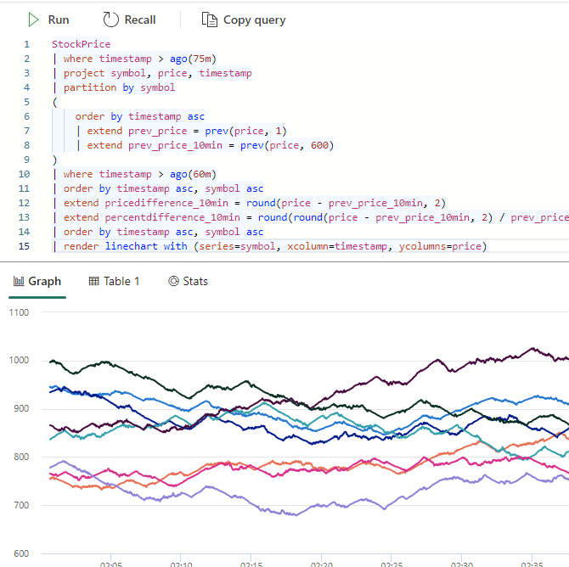
KQL Queryset
Overview
Uses the Kusto Query Language (KQL) for creating queries,
views, functions, control commands, customize results and
also supports many SQL functions.
Tabs in the KQL queryset can be associated with a different
KQL database.
Save queries for later use or share with others to
collaborate on data exploration.
You can also change the KQL database associated with any
tab, allowing you to run the same query on data in different
states.

Slide 27
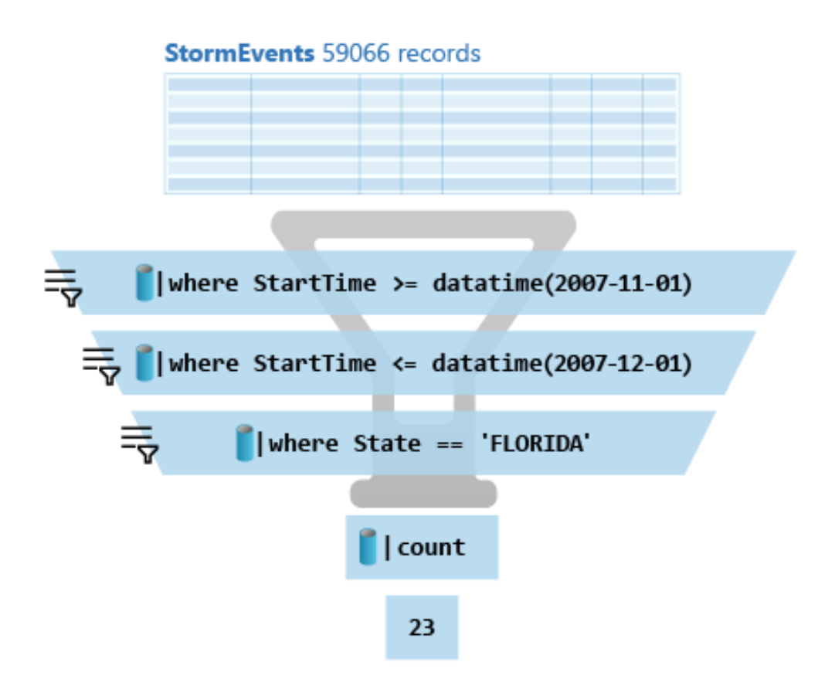
What is a Kusto query?
A Kusto query is a read-only* request to process data and return results.
Has one or more query statements and returns data in a tabular or graph format.
Statements are sequenced by a pipe (|). Data flows, or is piped, from one operator to the next.
It's like a funnel, where you start out with an entire data table.
The data is filtered/manipulated at each step and then fed into the following step.
Each time the data passes through another operator, it's filtered, rearranged, or summarized.
* Feb 2024: Update command now in preview

Slide 28
KQL Basic Operations
… | count
Counts records in input table (e.g. T)
… | take 10
Get few records - to familiarize yourself with the data. No actual order ensured.
… | where Timestamp > ago(10m) and UserId == 'abdcdef'
Filtering on a specific fields
… | project Col1, Col2, …
Choose some columns (great if input table has dozens of columns)
… | extend NewCol1=Col1+Col2
Introduces new calculated columns
… | sort by Timestamp ASC
Sorts result (also can use Order By)
… | render timechart
Render data into a visual plot while exploring

Slide 29
KQL Capabilities
Schema is
Relational, Lightweight, Dynamic
Databases
Authorization boundary
Transaction boundary
But not query boundary!
Supporting cross-database and cross-cluster queries
Tables
Rectangular
Columns
Supported types: boolean, integer, real, decimal, dates, timespan, string, dynamic (JSON)
Shortcuts (external data)
Stored functions (views)
Materialized views

Slide 30
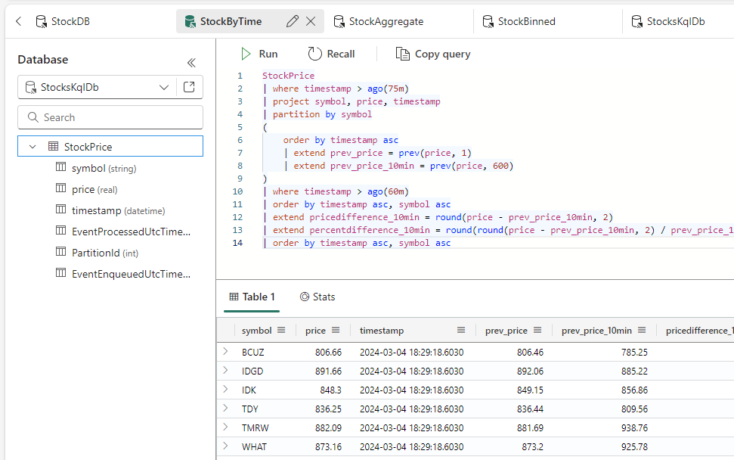
Module 2 – KQL Querysets
Goals: Interact with the underlying data via KQL queries
Begin writing queries to summarize data using Kusto Query Language. Similar to T-SQL, KQL is designed for data exploration and summarization.

Slide 31
Module 3 Power BI

Slide 32
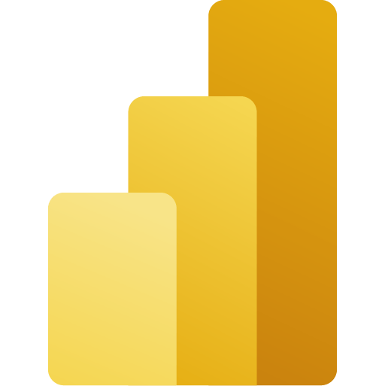










Power BI: The bridge between data and decisions
Consumption
Web
On-premises
Interactive reports, real-time dashboards, and paginated reports
Mobile
Data Warehouse
Embedded
Custom visualizations
Teams
Lakehouse
AI-infused insights and intuitive data exploration using natural language query
PowerPoint
Power BI service
SharePoint
Sharing and collaboration
Excel
Kusto (real-time analytics)
“…”
Notes:
Power BI enables individuals, teams and organizations to discover insights hidden in their data. Enabling everyone at every level to make confident decisions using up-to-the-minute analytics. It can connect to hundreds of data sources, both on-premises and cloud then allow you to share and collaborate on reports, real-time dashboards, all infused with AI.
One core capability of this unified self-service & enterprise BI platform is Power BI Embedded.
Power BI Embedded is a set of SDKs (.Net and JavaScript) that allows you to embed Power BI content such as reports, dashboards, tiles, etc., into web applications.
Sources:
https://docs.microsoft.com/en-us/power-bi/

Slide 33
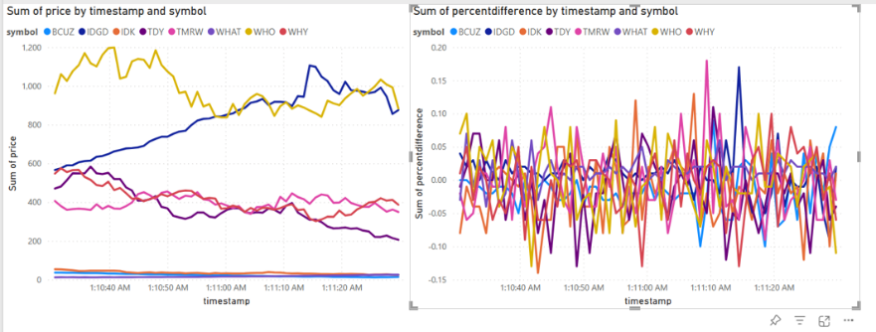
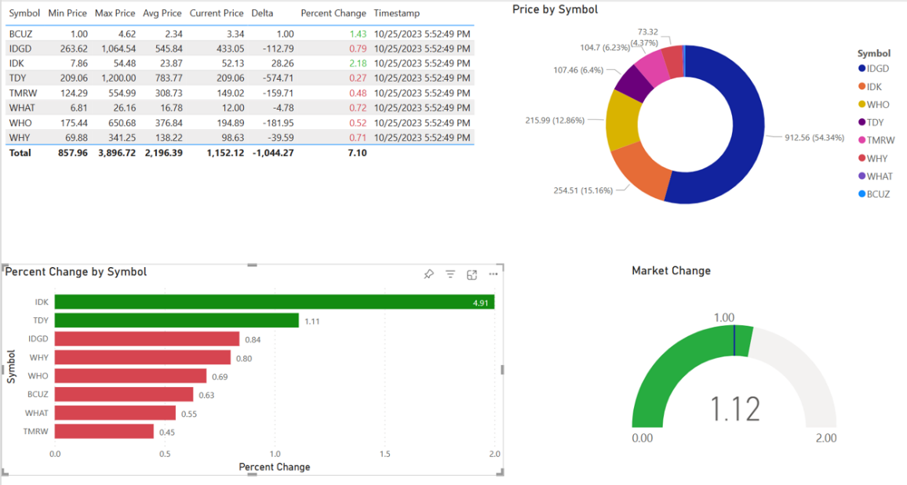
Module 3 – Reports in Power BI
Goals: Build a reports in Power BI to display real-time data.
KQL is the ideal engine to power fast, real-time dashboards. Using a combination of KQL summarizations and Power BI functions, compelling visuals can be created.

Slide 34
Module 4 Data Activator

Slide 35








Trigger actions on all your data, from one place
OneLake
Teams
Outlook
Data Activator
Power BI
No-code user experiences
Power Automate
Synapse Data Warehouse
Synapse Real Time Analytics
Custom
Models
Rules
Triggers
…
Real-time stream processing
…

Slide 36
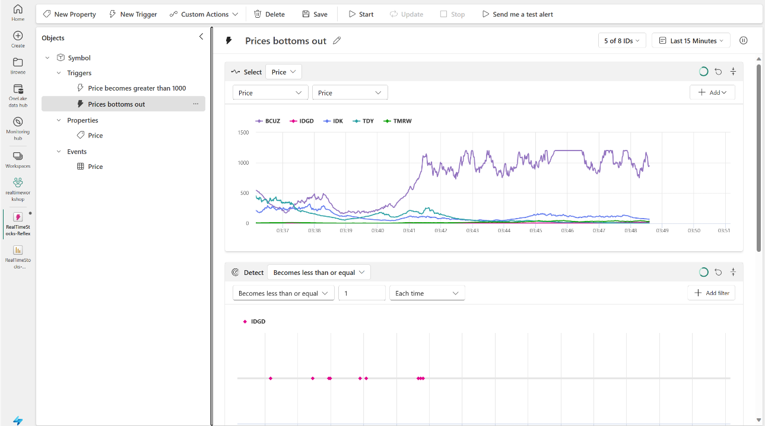
Module 4 – Data Activator
Goals: Configure alerting when prices reach certain levels.
This module will explore the configuration of Data Activator, an observability tool, to generate notifications when conditions in the underlying data are met.

Slide 37
Module 5 Synapse Data Warehouse

Slide 38
Common Data Warehouse Patterns
Data Source
Ingestion
Store
Expose
Shortcut Enabled
Mounts
Data Warehouse
PBI
Structured / Unstructured
Pipelines & Dataflows
Warehouse
Transform
Procedures
Notes:
The Data Warehouse analytics scenario takes existing sources that are mounted, while pipelines and dataflows can bring in all other data that is needed.
IT teams can then define and store procedures to transform the data, which is stored as Parquet/Delta Lake files in OneLake.
From there, business users can analyze and visualize data with Power BI, again using the see-through mode or SQL endpoints.

Slide 39
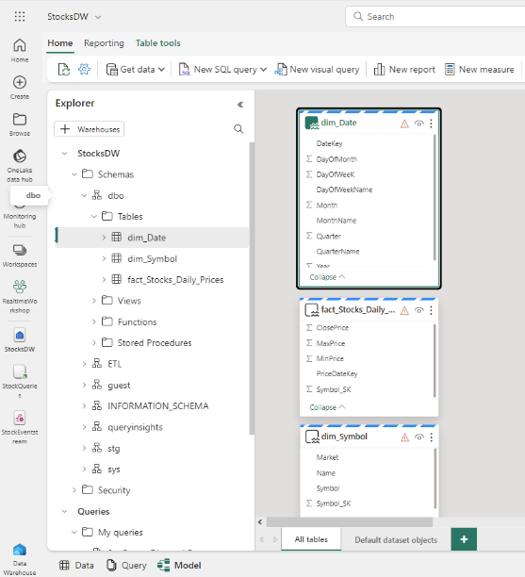
Key Capabilities
Data warehouse | Overview
Simple and intuitive warehouse experiences for both beginner and experienced data professionals
Lake-centric warehouse stores data in OneLake in open Delta format with easy data recovery and management
Fully integrated with all Fabric workloads out-of-the box
Data loading and transforms at scale, with full multi-table transactional guarantees provided by the SQL engine
Virtual warehouses with cross-database querying and a fully integrated semantic layer
Enterprise-ready platform with end-to-end performance and usage visibility, with built-in governance and security
Flexibility to build data warehouse or data mesh based on organizational needs and choice of no-code, low-code, or T-SQL for transformations
Enterprise scale data warehouse with open standard format
No knobs performance with minimal set-up and deployment, no configuration of compute or storage needed

Slide 40
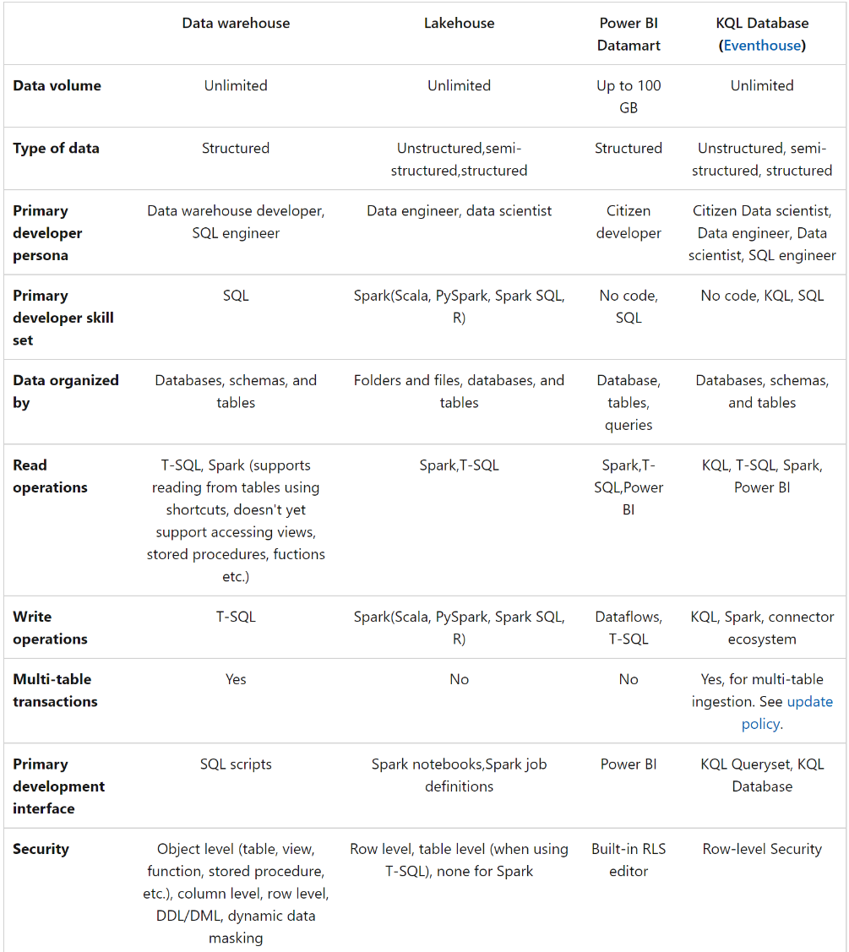
Fabric Data Warehouse
vs
Fabric Lakehouse
Decision Guide
https://learn.microsoft.com/en-gb/fabric/get-started/decision-guide-data-store
Search for: Fabric Warehouse Decision Guide

Slide 41
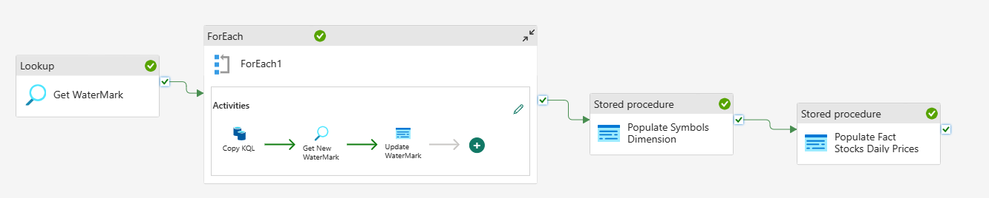
Module 5 – Data Warehouse
Goals: Build a dimensional model and data pipeline that stores aggregated data into a data warehouse.
Using the data warehousing capability, the data will be periodically loaded and summarized into a data warehouse for historic reporting. To accomplish this, we’ll use data pipelines for orchestration of an ETL pipeline.

Slide 42
Module 6 Data Lakehouse

Slide 43
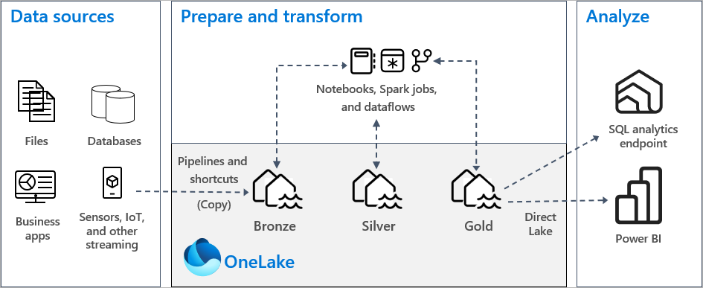
Common Lakehouse Architecture
Notes:
The Microsoft Fabric Lakehouse analytics scenario makes it so that data can be ingested into OneLake with shortcuts to other clouds repositories, pipelines, and dataflows in order to allow end-users to leverage other data.
Once that data has been pulled into Microsoft Fabric, users can leverage notebooks to transform that data in OneLake and then store them in Lakehouses with medallion structure.
From there, users can begin to analyze and visualize that data with Power BI using the see-through mode or SQL endpoints.

Slide 44
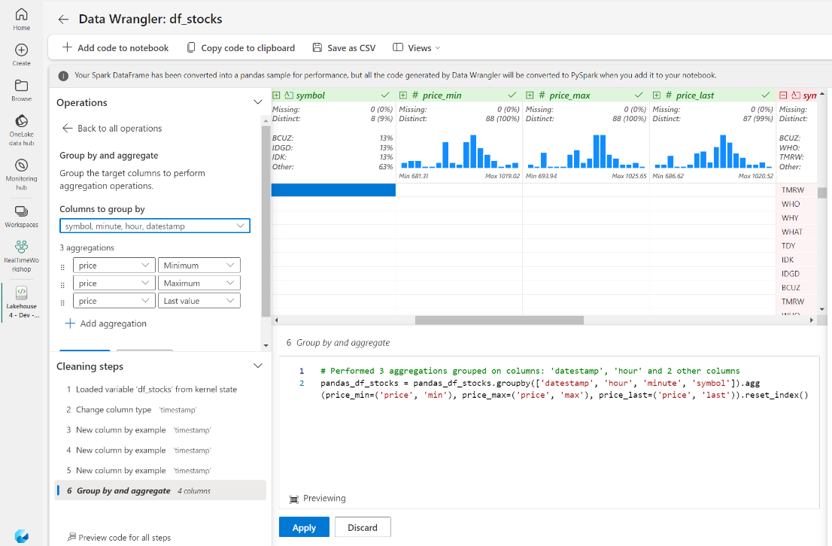
Module 6 – Data Lakehouse
Goals: Create a data lakehouse using data wrangler, notebooks, and Delta tables.
After modifying the Eventstream to copy data to the lakehouse, notebooks and data wrangler will be used to aggregate the data into tables that can be used for reporting and data science.

Slide 45
Module 7 Data Science

Slide 46
Common Data Science Patterns
Data Source
Clean & prepare
Store
Expose
Lakehouse & Data Warehouse
Notebooks
Lakehouse(s)
PBI
Train test & apply
Lake Warehouse
Models
Experiments

Slide 47
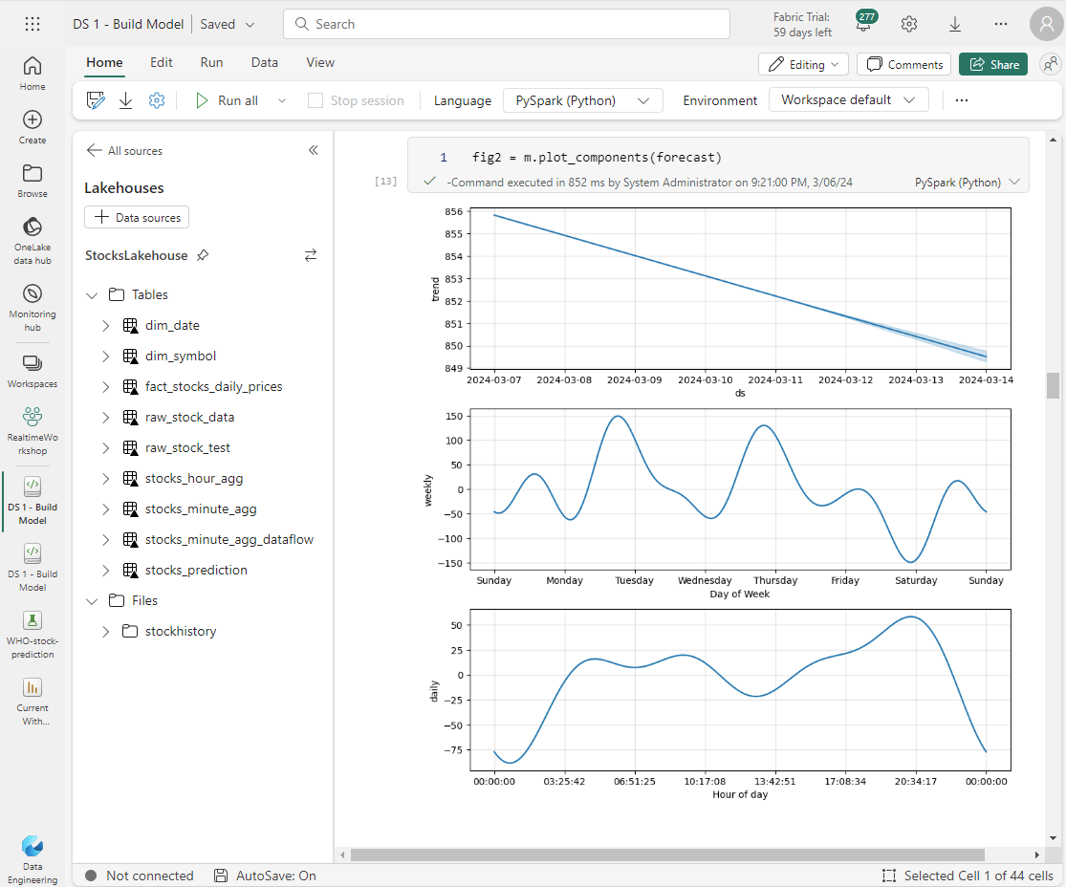
Explore, clean
and prepare
Faster exportation, cleansing and transformation of data with built-in experiences as part of the data science workload
Data Science workloads supports data cleansing, transformation, exploration, and featurization by leveraging built-in experiences on Spark as well as Python based tools
Key Capabilities:
Accelerate tedious and mundane tasks with Data Wrangler, a code tool to prepare data and generate Python code
Simplify data analytics, capture and exploit data semantics as users perform transformations on datasets
Leverage pre-installed open-source libraries for building visualizations like matplotlib, seaborn, Plotly, and more

Slide 48
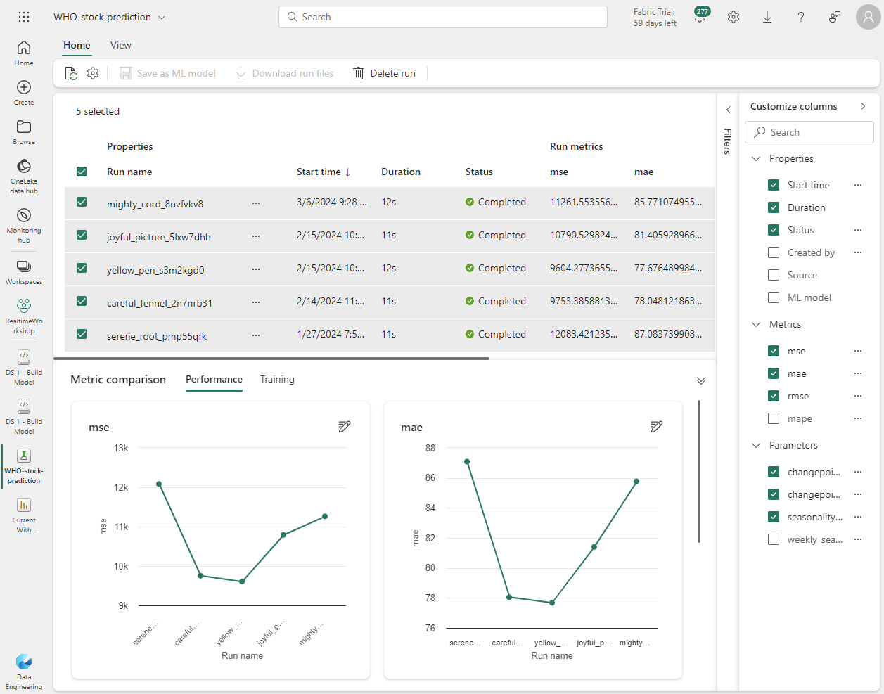
Machine Learning
with MLflow
Built-in model & experiment tracking enables data scientists to track and compare their different experiment runs and model versions
Train, evaluate, and score machine learning models by using built-in Experiment and Model artifacts
Key Capabilities:
Seamless integration with MLflow for experiment tracking and model registration/deployment
Automatically capture model pemtrics & parameters with built-in support for MLflow auto-plogging
SynapseML integration with Azure OpenAI service makes it easier to use Apache Spark to process millions of prompts and scale workflow
Model registry powered by AzureML

Slide 49
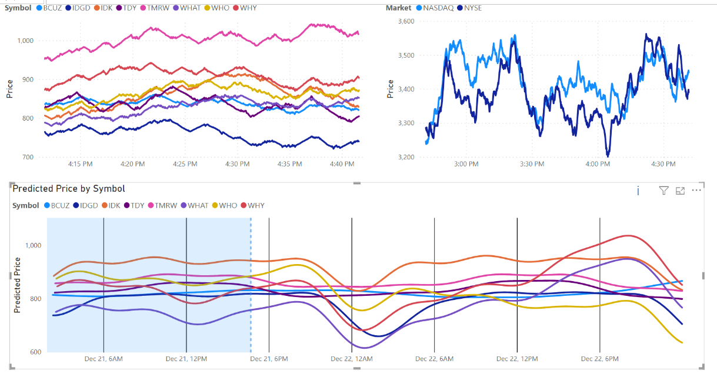
Module 7 – Data Science
Goals: Use notebooks to build an ML model predicting the stock prices.
Using the ML library Prophet, build a model and generate predictions, integrating them into the Power BI reports.
Using MLflow
DS 1 – Build & Log model
DS 2 – Consume Model
Generating without MLflow
DS 3 – Build/Generate ALL
DS 4 – Uses Module 6/Lakehouse “Live Data”

Slide 50



Azure ML vs Fabric Data Science
Azure Machine Learning is an E2E managed ML platform for building, fine-tuning, prompt-engineering, deploying, and operationalizing ML models responsibly at scale.
Microsoft Fabric is a unified solution for analytics, encompassing data integration, data engineering, data warehouse, data science, observational analytics, and business intelligence—all built on open, lake-centric foundations. Within Fabric, there is Data Science in Microsoft Fabric, a SaaS experience to build and use ML models to enrich data as part of data and analytics workflows.
Together you get a seamless Data & AI stack for your entire Data & AI team; from your data scientists, data engineers and machine learning engineers.
Your organization is invested in Azure ML
Your organization is invested in PBI and seeking impro data implementations
Your organization is invested in Azure Databricks
Choose Azure Machine Learning. Attach Microsoft Fabric for your data workloads. Optionally, Fabric DS can be used for EDA and feature engineering.
If you'd like to deploy models through managed endpoints, towards MLOps?
Choose Azure ML for ML workload. Attach Fabric for data workloads. Optionally, Fabric DS can be used for EDA and feature engineering.
If you'd like to deploy models through one-click flows in Fabric DW/Lakehouse or Power BI?
Choose Fabric DS for ML workload. Attach Azure ML for MLOps (CI/CD, model monitoring, etc.)
Your choice for data and ML workload to be on ADB or Fabric + AML. Attach Azure ML if you'd like to fine-tune, prompt-engineer, and deploy pre-built LLMs (Hugging Face, AOAI, Meta).

Slide 51


AzureML & Fabric: Top-line product differentiation
Azure Machine Learning
Microsoft Fabric
Value proposition
Azure Machine Learning is a managed end-to-end machine learning platform for building, fine-tuning, deploying, and operating ML models, responsibly at scale.
Ideal personas in your organization
Machine Learning Engineers, Data Scientists
Key capabilities
ML model building and training with any types of compute including Spark and GPUs for cloud-scale large AI workloads
Automated ML and drag-and-drop UI
End-to-end MLOps and repeatable ML pipelines
Prompt experimentation and LLM fine-tuning
Model deployment with REST API endpoints, real-time and batch inference
Value propositions
Microsoft Fabric is a unified solution for analytics—data integration, data engineering, data warehouse, data science, observational analytics, and business intelligence—all built on open, lake-centric foundations. Ideal personas in your organization
Data Engineers, Data Analysts, ITPros, DBAs, Data Scientists, Cloud Architects
Key capabilities
Data lake/data warehouse modernization
Data transformation and unification
Data visualization
ML model building and training

Slide 52
AzureML & Fabric: Top-line product capabilities
Azure Machine Learning
Data Science in Microsoft Fabric
Value proposition
Azure Machine Learning is a managed end-to-end machine learning platform for building, fine-tuning, deploying, and operating ML models, responsibly at scale.
Ideal personas in your organization
Machine Learning Engineers, Data Scientists
Key capabilities
ML model building and training with any types of compute including Spark and GPUs for cloud-scale large AI workloads
Automated ML and drag-and-drop UI
End-to-end MLOps and repeatable ML pipelines
Prompt experimentation and LLM fine-tuning
Model deployment with REST API endpoints, real-time and batch inference
Value propositions
Data Science in Microsoft Fabric empowers your data professionals to build and use machine learning models to enrich data as part of their data and analytics workflows, all built on top of secured and governed data in Microsoft Fabric.
Ideal personas in your organization
Data Scientists, Data Engineers, Data Analysts
Key capabilities
Data prep and code generation with Data Wrangler
Enrich data in your Lakehouse with scalable PREDICT function
ML model building and training with SynapseML (simple and distributed ML for Spark) with open-source libraries and 1P Azure AI services
Serving predictive insights through BI

Slide 53



AzureML & Fabric: 1000ft view of product integration
1
Data Pros and ML Pros access data items across all stages of the ML lifecycle by reading from and writing to OneLake. ADLS Gen 2 Shortcuts to OneLake can be used reference data from ADLS Gen 2 into OneLake.
Data Pros
2
ML Pros
2
Data Pros can train with Spark and access ML models in Fabric and deploy models using​ AzureML online and batch endpoints for production.
3
ML Pros can export models from AzureML to Fabric to enrich lakehouse or data warehouse serving data as part of analytics workflows.
Write predictions back to OneLake via Shortcuts to ADLS Gen2 and surface insights through PBI reports with Direct Lake mode.
Data Science in Microsoft Fabric
3
Azure Machine Learning
4
1
1
OneLake
4
ADLS G2 Shortcuts
Azure Data Lake Storage Gen 2 (ADLS G2)

Slide 54
Wrap-up, Q&A, & Feedback

Slide 55
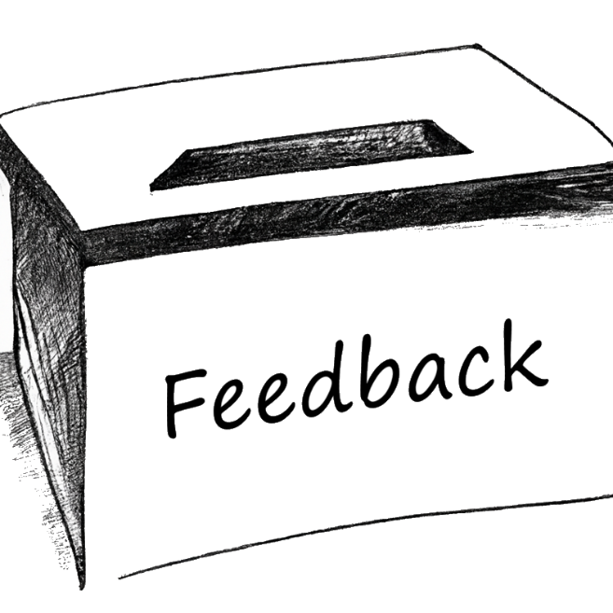
Wrap-up
Thank you for attending! Check out the additional challenges throughout the modules, and the Extras module with unique add-ons.
Comments or suggestions? Please let us know.
Get your questions answered in the Microsoft Fabric webinar series: https://aka.ms/fabric-webinar-series
See the latest announcements in the Microsoft Fabric blog site: https://aka.ms/fabric-tech-blog
Read the implementation guide: https://aka.ms/Getting-Started-eBook

